Slide 1


Opioid Crisis and State Response Update
Sara Goldsby
Co-Chair Opioid Emergency Response Team

Slide 2
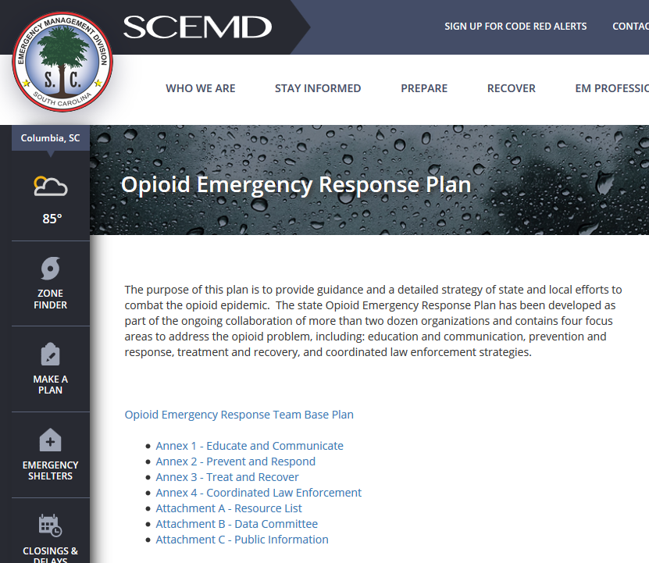

Slide 4
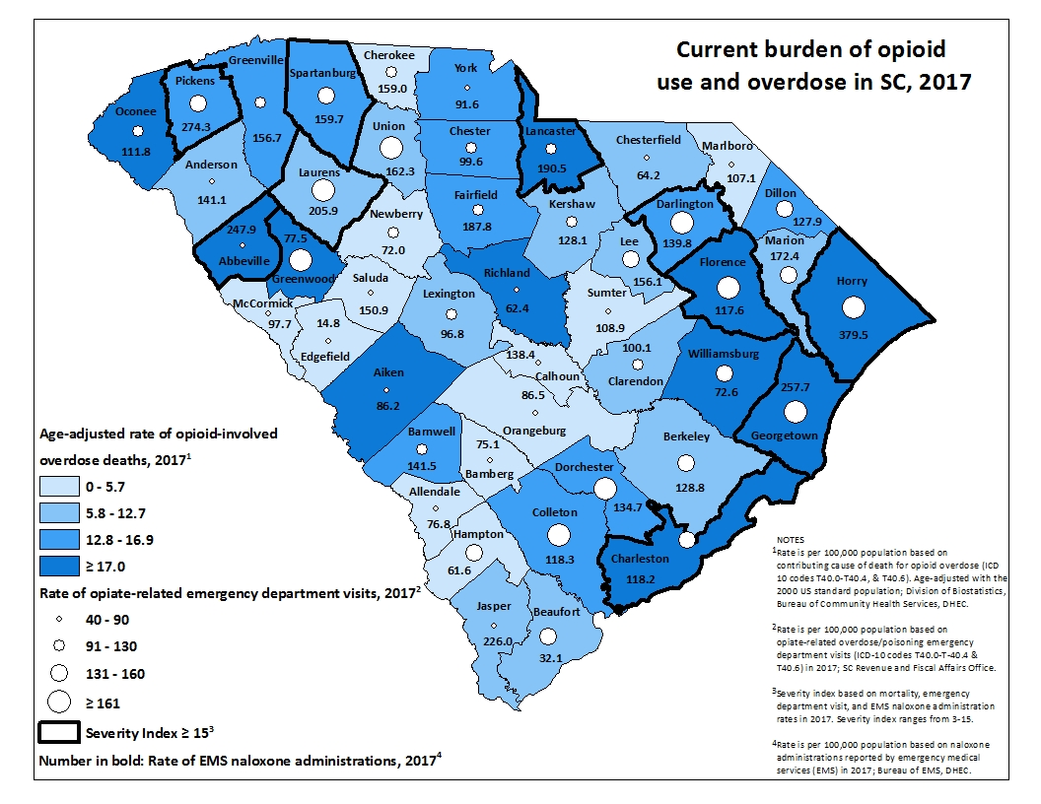


Slide 5

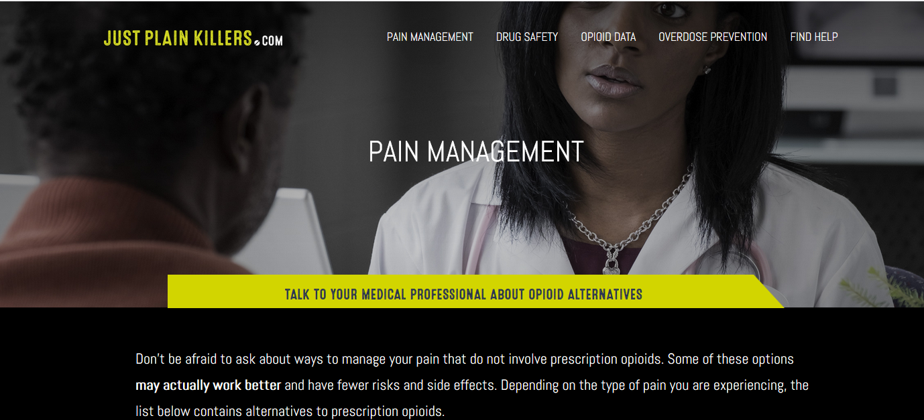
Education Campaigns

Slide 6
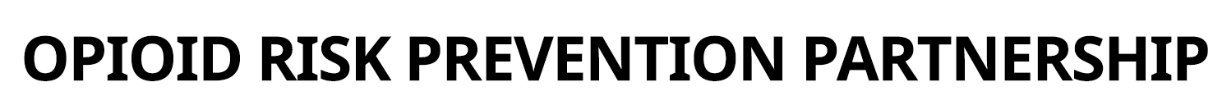
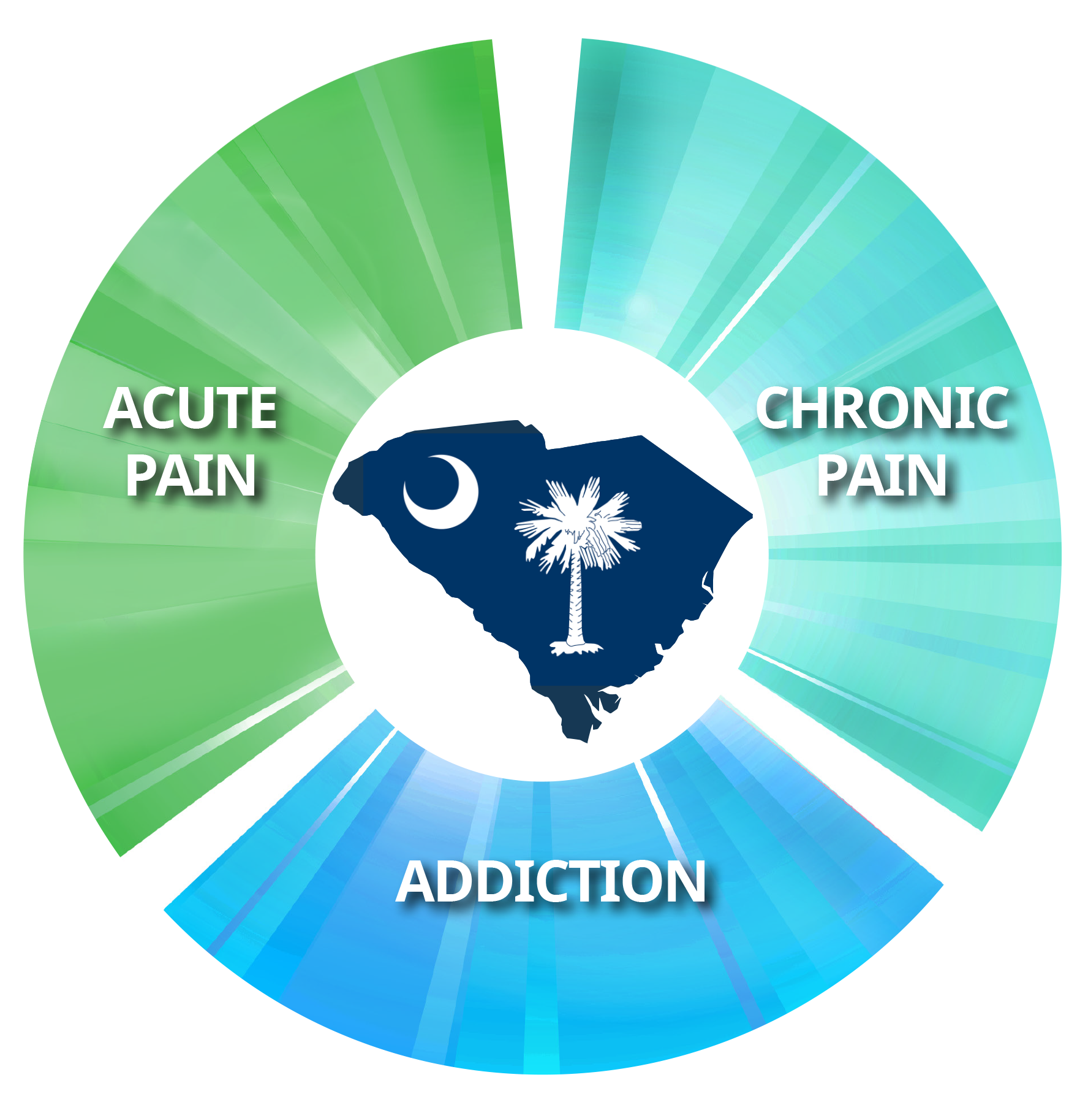


Education Campaigns
BlueCross BlueShield of South Carolina is an independent licensee of the Blue Cross and Blue Shield Association.

Slide 7

Legislative mandate:
              On May 19, 2017, the H.3824 was signed into law requiring practitioners to check the South Carolina PMP before issuing a CII prescription (with some notable exceptions). Expanded CE requirements on prescribing and monitoring controlled substances to other prescribers.

Slide 8

SCRIPTS Monthly Patient Record Searches
Source: DHEC BDC
C-II Rx Mandate

Slide 9
Monthly Number of Opioid Prescriptions Dispensed
Source: DHEC BDC
Payers' Mandate
C-II Rx Mandate

Slide 10
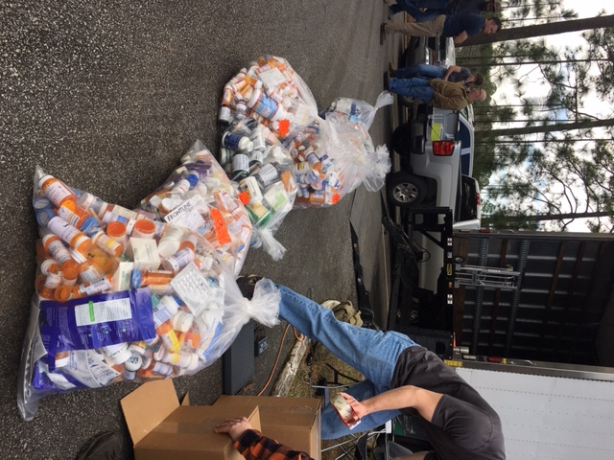

Coordinated Law Enforcement
Prescription Drug Take Back
February 2019
County Pounds
Spartanburg 51
Union 26
Oconee 221
Anderson 45
Greenville 1,068
Marion 121
McCormick 25
Lexington 470
Colleton 60
Kershaw 9
Fairfield 197
Charleston 217
Dorchester 17
Chesterfield 72
Cherokee 22
Beaufort 658
TOTAL: 3,665
April 2019
8,160 Pounds
Total 2019 Collection
11,825 Pounds

Slide 11

Law Enforcement Administrations of Naloxone
197 Agencies in All Counties
8,862 Officers Trained
861 Total administrations
254 YTD 2019
Source: DHEC BEMS

Slide 12


EMS Administrations of Naloxone
Source: DHEC BEMS
* 4030 YTD 2019

Slide 13
Medication-Assisted Treatment (MAT)
MAT Demand
Treatment Provision
Methadone & Therapy access to uninsured

Slide 14
More than 300,000 South Carolinians in Recovery
3 Sub-grants to support developing Recovery Community Organizations
  Served 3,406 individuals since September
3 additional sub-grants available for application
Oxford House Recovery Housing expanding to gap counties
43 inmates at SCDC Certified as Peer Support Specialists
National Association of Recovery Residences & South Carolina Alliance for Recovery Communities engaged

Slide 15
Moving Forward
Local Support for Prevention Strategies
Real-Time Overdose Surveillance for Proactive Response
Expand Evidence-Based Treatment (MAT)
Infectious Disease Testing and Treatment
Methamphetamine and Cocaine

Slide 16

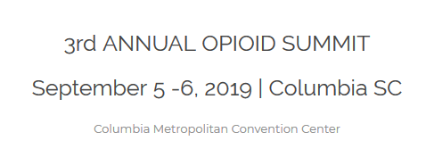
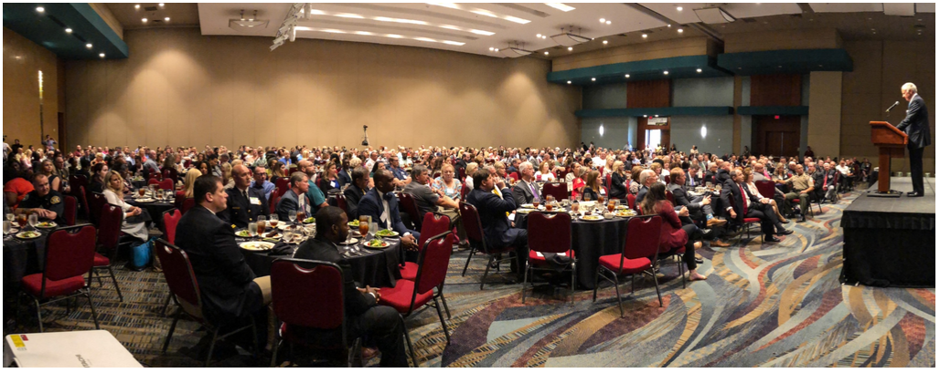
scopioidsummit.org
Notes:
SC Governor’s Opioid Summit September 5th and 6th.
800 attendees from across the state and all professions to learn and to celebrate, and to move to action.

